Slide 1
Ephesians 2
Walls Broken Down

Slide 2
Ephesians 2
And you were dead in the trespasses and sins ² in which you once walked, following the course of this world, following the prince of the power of the air, the spirit that is now at work in the sons of disobedience— ³ among whom we all once lived in the passions of our flesh, carrying out the desires of the body^{[a]} and the mind, and were by nature children of wrath, like the rest of mankind. ⁴ But^{[b]} God, being rich in mercy, because of the great love with which he loved us, ⁵ even when we were dead in our trespasses, made us alive together with Christ—by grace you have been saved—

Slide 3
⁶ and raised us up with him and seated us with him in the heavenly places in Christ Jesus, ⁷ so that in the coming ages he might show the immeasurable riches of his grace in kindness towards us in Christ Jesus. ⁸ For by grace you have been saved through faith. And this is not your own doing; it is the gift of God, ⁹ not a result of works, so that no one may boast. ¹⁰ For we are his workmanship, created in Christ Jesus for good works, which God prepared beforehand, that we should walk in them.

Slide 4
¹¹ Therefore remember that at one time you Gentiles in the flesh, called “the uncircumcision” by what is called the circumcision, which is made in the flesh by hands— ¹² remember that you were at that time separated from Christ, alienated from the commonwealth of Israel and strangers to the covenants of promise, having no hope and without God in the world. ¹³ But now in Christ Jesus you who once were far off have been brought near by the blood of Christ. ¹⁴ For he himself is our peace, who has made us both one and has broken down in his flesh the dividing wall of hostility

Slide 5
¹⁵ by abolishing the law of commandments expressed in ordinances, that he might create in himself one new man in place of the two, so making peace, ¹⁶ and might reconcile us both to God in one body through the cross, thereby killing the hostility. ¹⁷ And he came and preached peace to you who were far off and peace to those who were near. ¹⁸ For through him we both have access in one Spirit to the Father. ¹⁹ So then you are no longer strangers and aliens,^{[c]} but you are fellow citizens with the saints and members of the household of God,

Slide 6
²⁰ built on the foundation of the apostles and prophets, Christ Jesus himself being the cornerstone, ²¹ in whom the whole structure, being joined together, grows into a holy temple in the Lord. ²² In him you also are being built together into a dwelling place for God by^{[d]} the Spirit.

Slide 7
John 8 v 43 -44
⁴³ Why do you not understand what I say? It is because you cannot bear to hear my word. ⁴⁴ You are of your father the devil, and your will is to do your father's desires. He was a murderer from the beginning, and has nothing to do with the truth, because there is no truth in him. When he lies, he speaks out of his own character, for he is a liar and the father of lies.

Slide 8
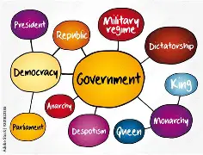

Slide 9
Genesis 3 v 4
⁴ But the serpent said to the woman, “You will not surely die. ⁵ For God knows that when you eat of it your eyes will be opened, and you will be like God, knowing good and evil.”

Slide 10
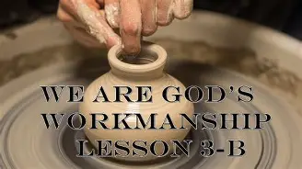

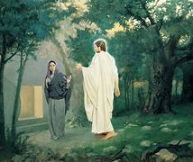
Promotion
His Workmanship
Kindness
Resurrection

Slide 11
Psalm 139 v 14
¹⁴ I praise you, for I am fearfully and wonderfully made.^{[a]}
Wonderful are your works;
my soul knows it very well.

Slide 12
Genesis 12 v 1 – 3
Now the Lord said^{[a]} to Abram, “Go from your country and your kindred and your father's house to the land that I will show you. ² And I will make of you a great nation, and I will bless you and make your name great, so that you will be a blessing. ³ I will bless those who bless you, and him who dishonours you I will curse, and in you all the families of the earth shall be blessed.”

Slide 13
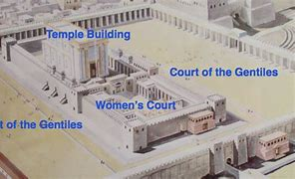

Slide 14
Ephesians 6 v 12
¹² For we do not wrestle against flesh and blood, but against the rulers, against the authorities, against the cosmic powers over this present darkness, against the spiritual forces of evil in the heavenly places.

Slide 15
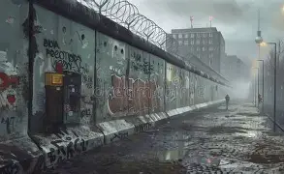
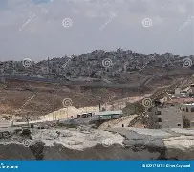

Slide 16
1 John 1 v 7
⁷ But if we walk in the light, as he is in the light, we have fellowship with one another, and the blood of Jesus his Son cleanses us from all sin.

Slide 17
Jews and Gentiles
Same Family
United
Citizens of God’s Kingdom
Peace through Jesus’s Blood
Access to the Father
All founded in Jesus
God’s Holy Dwelling
Apostles
Prophets
Jesus

Slide 18
Ephesians 4 v 1 - 7
I therefore, a prisoner for the Lord, urge you to walk in a manner worthy of the calling to which you have been called, ² with all humility and gentleness, with patience, bearing with one another in love, ³ eager to maintain the unity of the Spirit in the bond of peace. ⁴ There is one body and one Spirit—just as you were called to the one hope that belongs to your call— ⁵ one Lord, one faith, one baptism, ⁶ one God and Father of all, who is over all and through all and in all. ⁷ But grace was given to each one of us according to the measure of Christ's gift.

